Slide 1
Analysis on Predictors of Mental Illness in Tech Industry
Minhwa(Mina) Lee
Department of mathematics and computer science
The college of wooster

Slide 2
Introduction To Topic
Nearly one in five adults live with a mental illness (46.6 million in 2017) in the United States.
Rising Issues in tackling with mental health issues among workers in Tech Industry
Notorious for heavy workloads
Stigma on the co-workers with mental illness
Study Question
Which factors affect the workers’ chance of having mental illness
while working in the technology industry?
Notes:
Let me first introduce how I have come up with this topic. According to National Institute of Mental health in the United States, nearly one in five adults live with a mental illness.

Slide 3
Data Processing
A Survey in 2014 by Open Sourcing Mental Illness (OSMI) in the United States
Total 1,031 Responses
Dependent Variable
Workers’ Medical history of treatments for mental health issues
Independent Variable
Personal Level : Age, Family history of mental illness, etc.
Employees’ perspective toward mental illness
The Working Environment (Employers)

Slide 4
Main Focus of Research
General Analysis of Data
Personal Information
Workers’ Perspective toward Mental Health Issues in the Workplaces
The Working Environment (Employers)
Predictors of Mental Illness in Tech Industry
Logistic Regression
Stepwise Regression
Random Forest
Feasible Approaches for Employers to Improve Working Environment

Slide 5
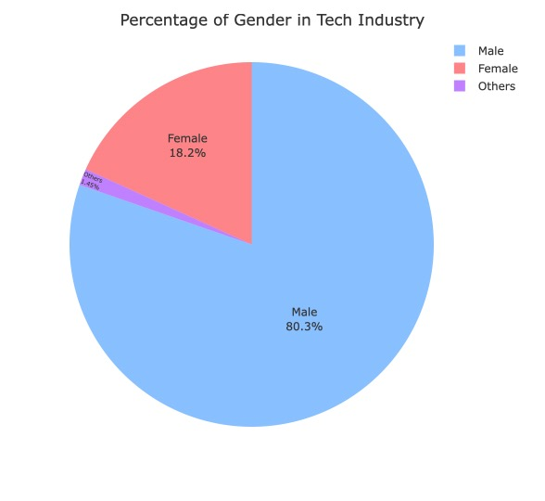
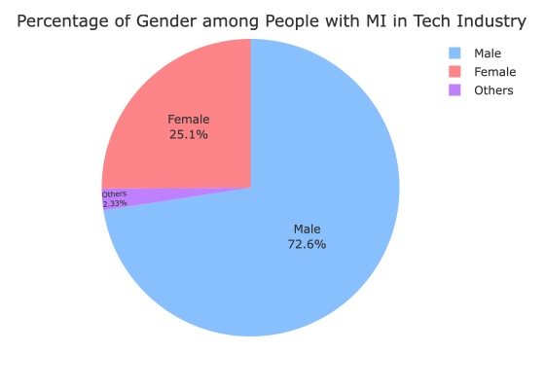
A. General Analysis – 1) Personal Level
Notes:
First section of my research is the general analysis of the dataset.
I first examined the personal information of the respondents in the survey.
About 80 percent of workers in the survey are male, and among people with mental illness, 72.6 percent of people are found to be male.

Slide 6
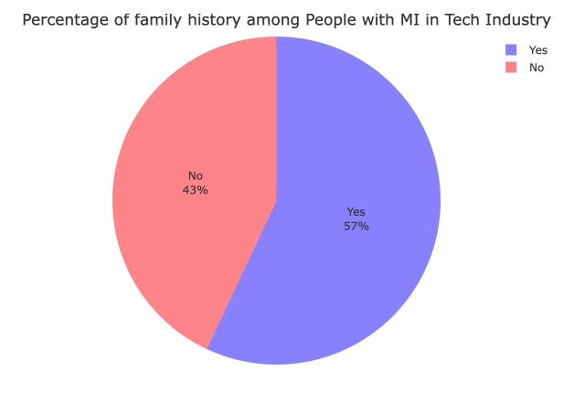
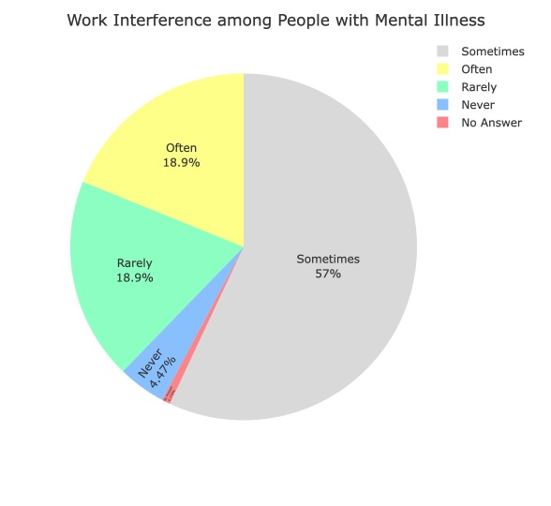
Notes:
57% people with mental illness said they have family history of mental illness
On the right chart, over 70 percent of people with mental illness said they have experienced any interference due to mental illness while they’re working in Tech industry.

Slide 7
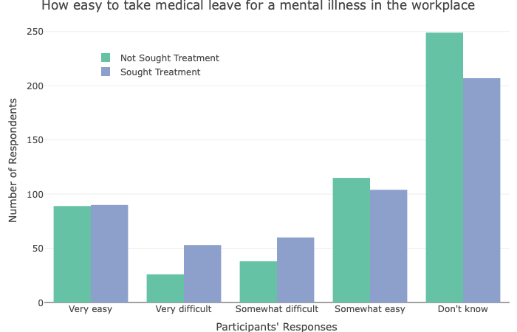
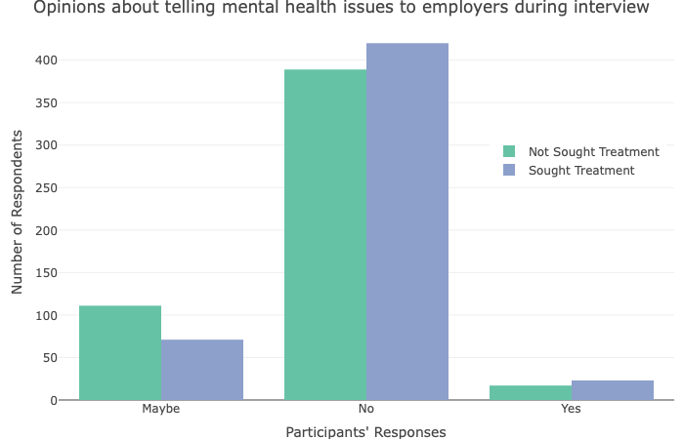
(2) Employee’s Perspective toward Mental Illness in the Workplaces
Notes:
For the second category of employees’ perspective toward mental illness in the workplaces, I divided the dataset into two groups of people: so one is those who have sought treatment for mental illness or the other is those who haven’t.
The first variable that I examined is how easy to take a medical leave for a mental illness in the workplace. Although most of people in both two groups don’t know much about the leave, people with mental illness said they feel somewhat or very difficult to take a medical leave for mental illness, compared to the other group who have not sought treatment for mental illness.
Also, on the right side, most of people in both groups said they will not bring up their mental health issues to potential employers while having job interviews.
So, those seems like employees have pretty much negative viewpoint toward mental illness in the workplaces.

Slide 8
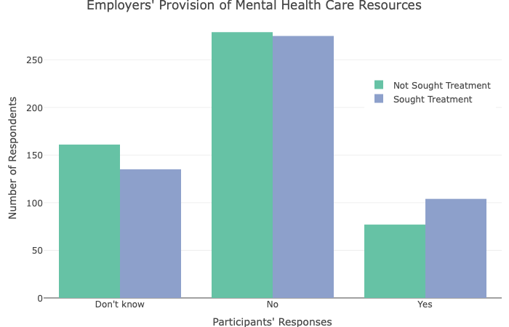
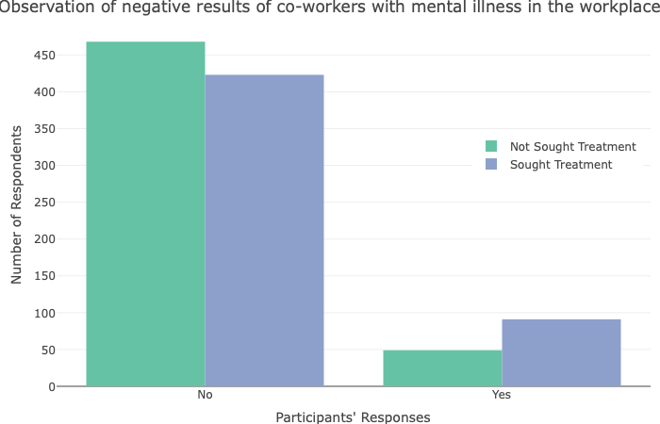
(3) The Working Environment
Notes:
For the last analysis, I also investigated the working environment created by employers.
For the question of whether employers provide mental health care resources to the workers, most of respondents said they either don’t know or don’t experience that health care offers from their employers.
Lastly, although both of two groups said they haven’t yet observed the negative results of co-workers having mental illness, people with mental illness takes a higher proportion to agreeing that they have any experienced about that discrimination in the workplaces.

Slide 9
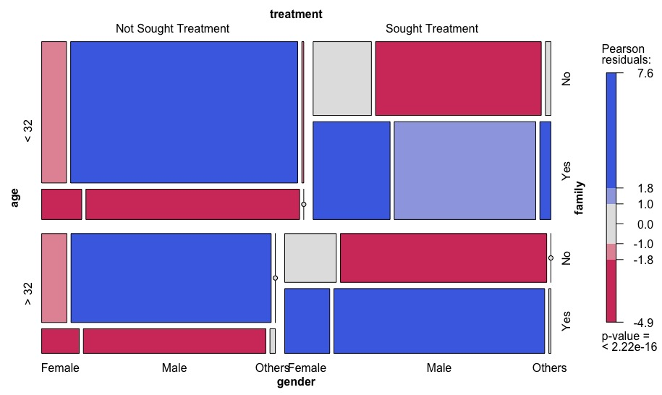
B. Predictors of Mental Illness - (1) Logistic Regression
Process
Results
Baseline Model
Include All variables (Full Model)
Factor Selection
Include variables with small p-values
Use Mosaic Plot
Notes:
Based on the general analysis part, then I analyzed each predictor of mental illness in the dataset by using several kinds of methodologies to create a predictive model.
First method is logistic regression.
I first built a base line model which included all the variables in the dataset.
Then, for creating another model with logistic regression, I used a technique of mosaic plots to see the relationship between each independent variable and the target factor.

Slide 10
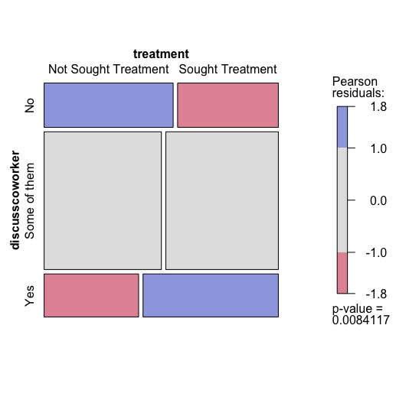
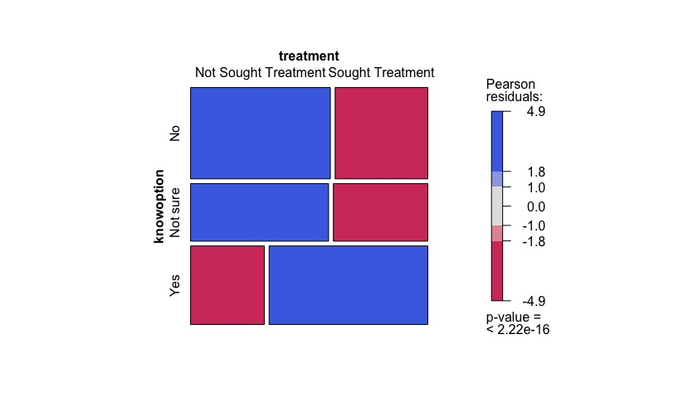
Willingness to Discuss Mental Health Issues with Co-workers
Employers’ Provision of Healthcare Option for Mental illness
Notes:
Let me explain how to interpret the mosaic plot. The size of rectangles means the number of responses to the combination of features, and we can compare the number of responses by looking at the width or height of each rectangle box.
For example, if we say you are willing to discuss your mental illness with co-workers, then you see each two boxes at the bottom, and you can see on the plot that people who have tried medical treatment for mental illness take higher proportion to the other group.
Also, on the right plot, you can figure out that when it comes to saying how you much know about mental care options for mental illness, you see workers with mental illness takes a higher proportion to the other group. That’s how we interpret the mosaic plot to get the association between two variables.

Slide 11
Factor Selection Through Logistic Model
Baseline Model (Full Model) | Model selected by Mosaic Plot
All Personal Information (Age, Family History of Mental illness, Gender, and Feeling work Interference) Employers’ Provision of Healthcare option for Mental illness
x | - Provision of Resources for mental health issues
 | - The observation of negative results of co-workers with mental illness
 | - Employees’ willingness to bring up their mental illness during job interview
 | - Employees’ anticipation of negative results by discussing mental issues with their employers
Notes:
This table shows the factors that are found to be significant in predicting the workers’ chance of having mental illness while working in the Tech industry.
.
Those two models commonly showed that personal information and employers’ provision of healthcare option for mental illness are important, but in addition to that, the model which used the mosaic plot, showed that those following four variables are also significant to predicting the mental illness

Slide 12
(2) Stepwise Regression
Process
Results
Repeat entering and removing predictors
Use R-packaged function
Same Algorithm with Logistic regression
Top 5 Important Variables
Gender
Family History of Mental Illness
Feeling of Work Interference Due to Mental Illness
Provision of Healthcare option for mental illness
Willingness to discuss with co-workers about mental health illness
Notes:
Second methodology that I used for factor selection is stepwise regression.
This has same algorithm with logistic regression, but it’s different from the logistic one that stepwise one repeat entering and removing predictors when making a model.
I used a function in R-package, and the results of factor selection through stepwise regression is like this in the table;

Slide 13
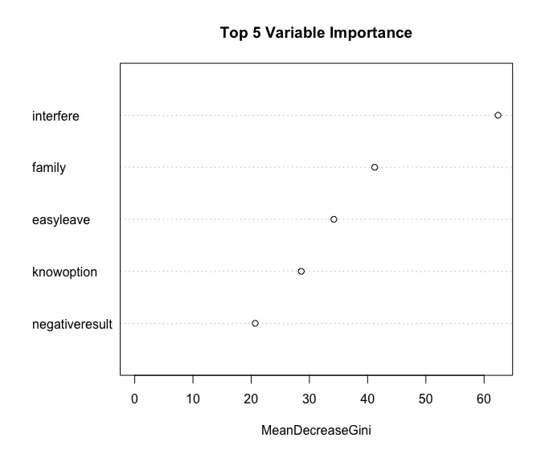
(3) Random Forest
Process
Results
Rank the importance of variables for the classification model
Use R-Package function
500 trees, 6 variables for each split
Top 5 Important Variables
Feeling Work Interference due to Mental Illness
Family History of Mental Illness
How Easy to Take a Medical Leave for Mental Illness
Provision of Healthcare option for mental illness
Experience in Negative Results for Co-workers with Mental Illness
Notes:
Last method for factor selection is Random Forest.
This one is highly useful to rank the importance of a set of variables when creating either regression or classification model.
SO, I use a r-packaged function and set 500 as default values of making trees, and got 6 as the optimal value for each split of trees.
The result looks like the plot, and this table shows the list of top most 5 important variables in predicting the mental illness.

Slide 14
C. Approaches for Better Working Environment
Commonly Important factors
Suggestions
Family History of Mental illness
Work Interference
How employees know health care options for mental illness provided by their employers
Medical Resources from Employers (Companies)
Discussion with co-workers about mental illness
“ No More Stigmatization on Mental Illness”
Provide Educational Resources about Mental Illness
Hold a regular seminar of how to respect co-workers with mental illness
Offer a more healthcare option for mental health issues as benefits for employees
Limitation on Research
- Not much direct relation to technology industry
Focus on Employees’
Working Environment in Tech Industry
Notes:
This is the last section of my research, which suggests some possible solutions for creating a better working environment to be free of worries about mental illness.
So those five variables are commonly shown in all models that I made for prediction, and you can see that in addition to personal information, how employees view mental illness or their working environment also play important roles in increasing the probability of having mental illness among workers.
And I focus on employees’ working environment in Tech industry.
I used a sociology article that indicates that there are social stigma and discrimination to a worker with mental illness in the workplaces, and the author claimed that this is because employees are generally uneducated to a certain problem of how to deal with mental illness.
There are limitation on my research, which is there are not much direct relation on the independent variables to the target variable, and also this is not confined to tech industry. So for future research, gathering more collection of data which also includes specific information about tech industry, will better improve the quality of my research project in the future. Thank you.

Slide 15

Thank you! Any Question?

Slide 16
Works Cited
Baldwin, M.L. and Marcus, S.C. “Perceived and measured stigma among workers with serious mental illness," Psychiatric Services, vol. 57, no. 3, 2006, pp. 388 – 392.
Brohan, E., et al. “Systematic review of beliefs, behaviours and influencing factors associated with disclosure of a mental health problem in the workplace," BMC Psychiatry, vol. 12, no. 11, February 2012.
Department of Human Genetics - Division of Medical Genetics, “Family history of mental illness," Emory University School of Medicine, 2008.
Gabriel, P., and Liimatainen, M.R. and International Labor Office, Mental Health in the Workplace: Introduction, Executive Summaries. International Labor Office Geneva, 2000.
Google, “How we care for Googlers,” Google Career, Accessed April 25, 2019, https://careers.google.com/how-we-care-for-googlers/
Kanwar, Y.P.S., et al. “Work-Life Balance and Burnout as Predictors of Job Satisfaction in the IT-ITES Industry.” Vision, vol. 13, no. 2, Apr. 2009, pp 1-12.
Open Source Mental Illness (OSMI), Mental Illness in Tech Survey, OSMI, 2014

